Slide 1
Flairdocs Workflow Designer Project
Demo 2
By the Null Pointers

Slide 2
Demo 2 Mission and Objectives
Preliminary DOJO integration
Database integration
Save a workflow
Search for a workflow
Open a workflow

Slide 3

New Tools Used
DOJO: border panel and live splitter
Select2: JQuery search bar framework
Microsoft C# Unit Test: controller testing

Slide 4
Demo 2 Requirement Traceability Matrix
Stakeholder | Priority | Feature | Use Case | Points | Test | Passed
Iteration 5: 10/27 - 11/3, Demo 2 (Planned: 26, Actual: 26)
Admin | 2 | Workflow Processing | Save a workflow | 13 | 3 | 3
Admin | 3 | Workflow Processing | Search for a workflow | 5 | 4 | 4
Admin | 4 | Workflow Processing | Open a workflow | 8 | 4 | 4

Slide 5
Product Backlog
Stakeholder | Priority | Feature | Use Case | Points
Admin | 1 | Workflow Processing | Create a workflow | 21
Admin | 2 | Workflow Processing | Save a workflow | 13
Admin | 3 | Workflow Processing | Search for a workflow | 5
Admin | 4 | Workflow Processing | Open a workflow | 8
Admin | 5 | Workflow Designer Tool | Add a step to workflow | 21
Admin | 6 | Workflow Designer Tool | Add reviewer to step | 8
Admin | 7 | Reviewer configurations | Set person as reviewer | 8
Admin | 8 | Reviewer configurations | Create actions for user role | 8
Admin | 9 | Reviewer configurations | Attach XML | 3
Admin | 10 | Reviewer configurations | Set prerequisites for reviewers | 5
Admin | 11 | Step configurations | Set requirement to advance to next step | 5

Slide 6
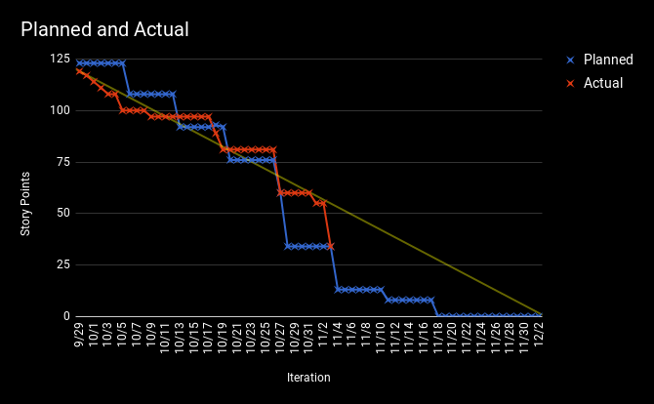
Release Burndown Chart

Slide 7
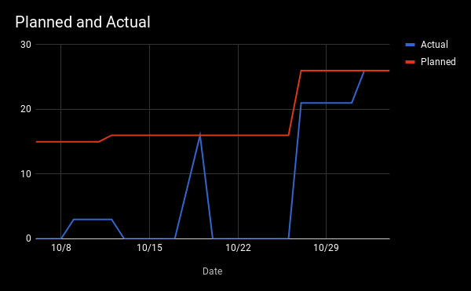
Demo Burnup Chart

Slide 8
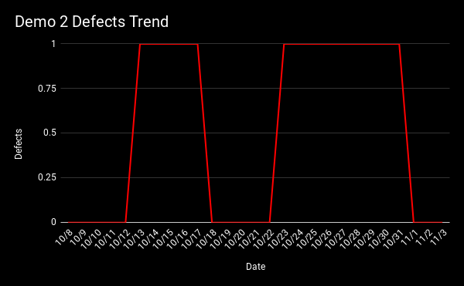
Defect Trend Chart
DOJO gutters
Test database didn’t sync with actual database

Slide 9
Regression Test Suite

Slide 10
Live Demo

